Slide 1
A3435 – Major Project Domain: Signal & Image Processing
VARDHAMAN COLLEGE OF ENGINEERING, HYDERABAD
Autonomous institute, affiliated to JNTUH
Team No. – 2017040404
Practical Implementation of Image Processing based Vehicle Speed Monitoring System
17881A04K2 – J.Hrudaya
17881A04M4 – Rithika Rao.D
17881A04P8 – B.Vinoothna
By:
Under the guidance of
Dr.D.KRISHNA
Associate Professor, Dept. of ECE

Slide 2
Practical Implementation of Image Processing based Vehicle Speed Monitoring System
Outline:
Objectives
Literature Survey
Proposed Design
Results and Discussion
Comparative Analysis
Conclusion and Future Scope
References
Details of Publications

Slide 3
Practical Implementation of Image Processing based Vehicle Speed Monitoring System
Objectives:
The idea behind our project is to detect the speed of vehicles which is an important aspect for observing speed limitation law and traffic condition.
It is also a method to control over speed vehicles.

Slide 4
Practical Implementation of Image Processing based Vehicle Speed Monitoring System
Literature Survey:
Paper Title
Vehicle Speed Detection from Camera Stream Using Image Processing Methods
Authors
Jozef Gerát, Dominik Sopiak, Miloš Oravec, Jarmila Pavloviˇcová
Journal
IEEE ,59th International Symposium ELMAR-2017
Proposed work
The paper deals with the topic of detection of vehicle speed based on information from video record. It comprises the tests of obtained video records using different vehicles, different natures of driving and the vehicle position at the time of recording.
Techniques involved
Gaussian mixture models, DBSCAN, Kalman ﬁlter, Optical ﬂow.

Slide 5
Practical Implementation of Image Processing based Vehicle Speed Monitoring System
Literature Survey:
Paper Title
Speed Detection using Image Processing
Authors
Pranith Kumar Thadagoppula, Vikas Upadhyaya
Journal
IEEE 2016 International Conference on Computer, Control, Informatics and its Applications
Proposed work
Use mere CCTV cameras on highways to detect the speed of vehicles. The prototype developed is designed using MATLAB software and can process on core2duo processor with 2Ghz.
Techniques involved
Background subtraction, Adaptive Background subtraction , Object segmentation, Object labeling, bounding box and Calibration factor-real-world distance to pixel ratio.

Slide 6
Practical Implementation of Image Processing based Vehicle Speed Monitoring System
Literature Survey:
Paper Title
Vehicle speed detection using video streams using image processing
Authors
Mohammed Reduanal Haque, Md.Golam Moazzam, Saiful Islam, Rony Das
Journal
IEEE 2016 International workshop on Computational Intelligence(IWCI)
In this paper, they have developed an image-based vehicle speed detection where a physics based velocity theory is used to calculate speed of moving vehicle from the recording video.
Proposed work
Techniques involved
Five major techniques used ,image acquisition and enhancement, segmentation, centroid, calculation, shadow removal and speed calculation. For vehicle speed detection: temporal differencing algorithm. Noise removal: trial and error method.

Slide 7
Practical Implementation of Image Processing based Vehicle Speed Monitoring System
Literature Survey:
Paper Title
Image processing based vehicle detection and tracking method
Authors
Prem Kumar Bhaskar, Suet-Peng Yong
Journal
IEEE, 2014 International Conference on Computer and Information Sciences
Proposed work
Paper aims to develop an automatic vehicle counting system, which can process videos recorded from stationery cameras over the road for traffic data retrieval.
Techniques involved
Gaussian Mixture Model (GMM)-used to separate the objects in motion for the count. Blob Detection technique-to trace the movements of the objects within the frame. Blob analysis -identifies potential objects and puts a box around them.

Slide 8
Practical Implementation of Image Processing based Vehicle Speed Monitoring System
Literature Survey:
Paper Title
A Review on Video Based Vehicle Detection, Recognition and Tracking
Authors
Shobha B S, Deepu R
Journal
3rd IEEE International Conference on Computational Systems and Information Technology for Sustainable Solutions 2018
Proposed work
They have been proposed for detection which includes appearance based models and motion based models .Vehicle recognition based on various attributes such as color, license plate, logos are discussed. Region based and feature based tracking along with various tracking algorithms are surveyed. Multi-view methods for vehicle detection are also discussed.
Techniques involved
It describes Single camera approach, Multi camera approach and summarizes the findings.

Slide 9
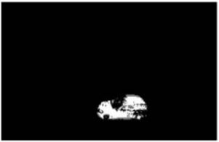
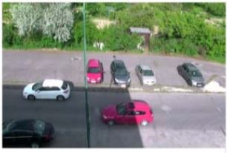
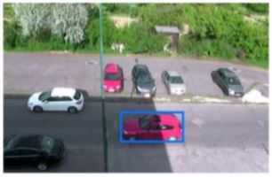
Practical Implementation of Image Processing based Vehicle Speed Monitoring System
Proposed Method (Design):
Foreground Detection
Find Bounding Boxes
DBSCAN
Detect path using Kalman Filter
Estimate average velocity
Visualize

Slide 10
Practical Implementation of Image Processing based Vehicle Speed Monitoring System
DATABASE: The input is taken in the form of a video which is captured using a camera whose screen size will be 1280x1024. For the data base, 4 videos of similar resolution are taken.
FOREGROUND DETECTION: It is based on Adaptive Background Subtraction which is called as Gaussian Mixture model where the background of the image is subtracted to detect the required object by comparing the pixel value with the threshold value and classified into foreground and background image.
DBSCAN(Density based Spatial clustering of Application with Noise): The set of foreground points are specified using clusters which are given by Gaussian mixture model which are closely packed together to form an outline which is marked by bounding boxes.
BOUNDING BOXES: They are circumcised rectangles used for easy representation of the clusters.
DETECTION PATH USING KALMAN FILTER: It uses series of measurements over a period of time which includes statistical noise, inaccuracies and estimates the value of unknown variable. It’s working simply is based on predicting the current state variable along with uncertainties and calculating the next state variables and then updating the previous state variables.
ESTIMATION OF AVERAGE VELOCITY: (distance/no. of frames)*k
let the distance be assumed as 10m
no. of frames= the difference between final frame and initial frame
k=constant value
for the first vehicle, the speed is assumed and then the constant value k is calculated. With respect to the calculated
k value, the speed of remaining vehicles is calculated using the formula.

Slide 11
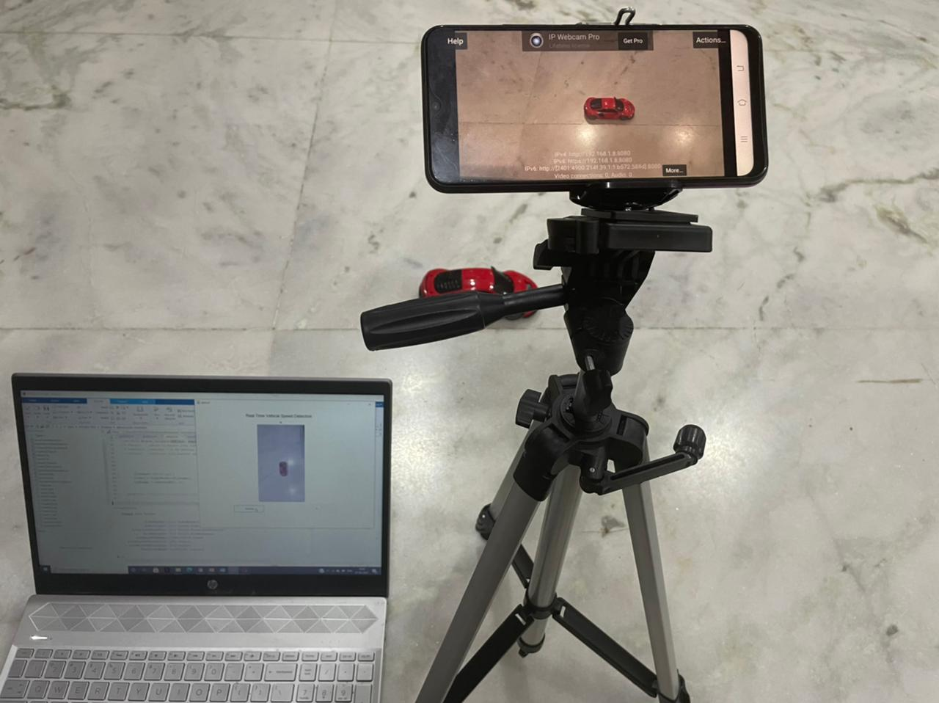
Practical Implementation of Image Processing based Vehicle Speed Monitoring System
7. VISUALIZE: It is simply testing where series of videos are taken into consideration and techniques mentioned are performed and concluded whether the respective vehicles exceeded the speed or not.
HARDWARE SETUP
The hardware setup is shown in the image where laptop and phone are connected through IP address of WI-FI using an app called IP Webcam.
The phone camera is used to record the movement of the vehicle.
The speed of the vehicle is calculated and displayed using the algorithm developed in the MATLAB software.

Slide 12
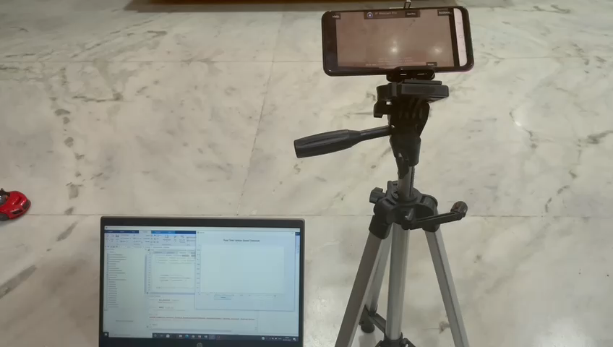
Practical Implementation of Image Processing based Vehicle Speed Monitoring System
Working of hardware setup

Slide 13
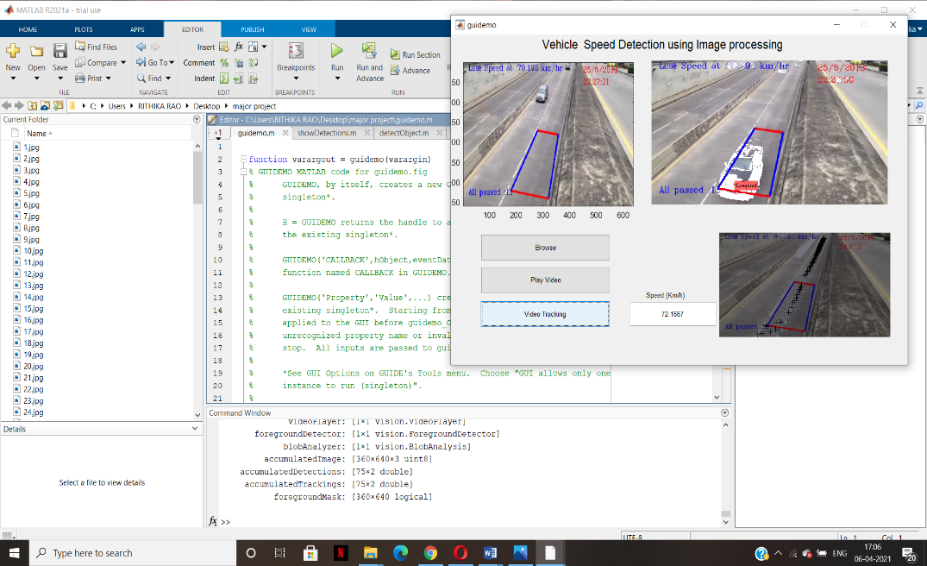
Practical Implementation of Image Processing based Vehicle Speed Monitoring System
Results and Discussions:
SOFTWARE OUTPUT
The picture depicts the calculated speed of the vehicle when it travels through the masked points.

Slide 14
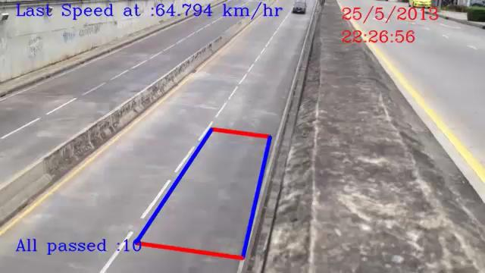
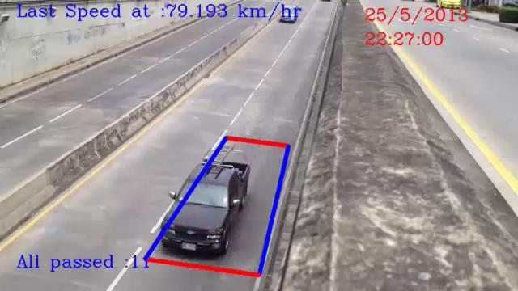
Practical Implementation of Image Processing based Vehicle Speed Monitoring System
The car hasn’t reached the mask
The car has reached the mask
When the car passes the starting point, it indicates the first frame and the ending point is indicated as second frame. The calculated speed is displayed when the car is passed through these two frames.
The distance between these frames is considered to be 10 meters. In the first image car hasn’t reached the starting point while in the second image car passed through starting point and reached the end point.
This is the point where the speed calculated is displayed.

Slide 15
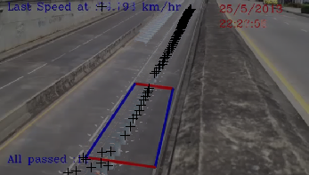
Practical Implementation of Image Processing based Vehicle Speed Monitoring System
Tracked path
To annote the tracked object we have used Kalman Filter as shown in the image above.

Slide 16
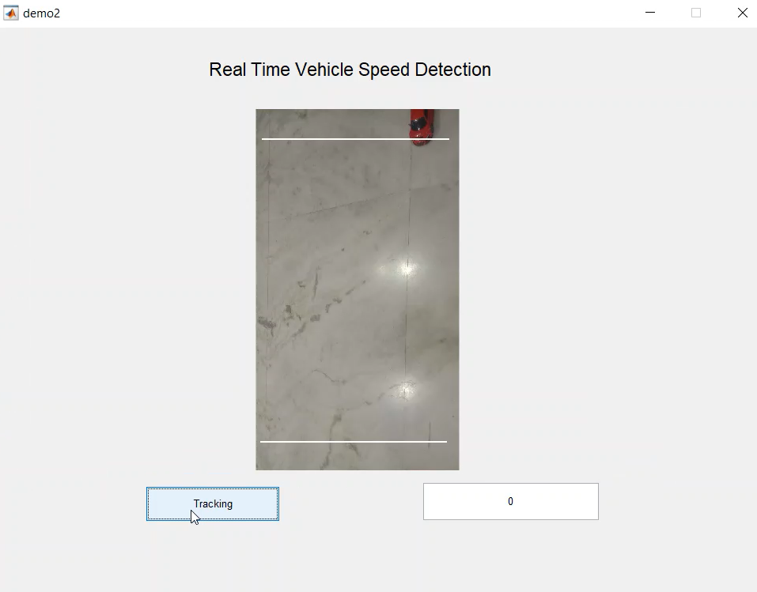
Practical Implementation of Image Processing based Vehicle Speed Monitoring System
HARDWARE OUTPUT
The car has reached the point one i.e. the first masked position. The speed is calculated when the vehicle passes through the second position.

Slide 17
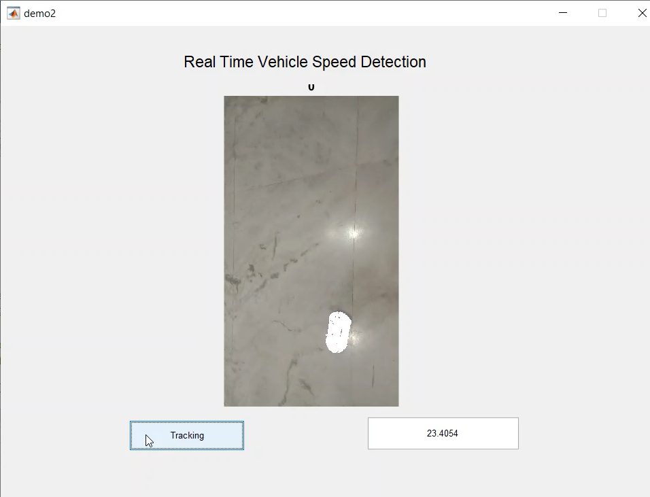
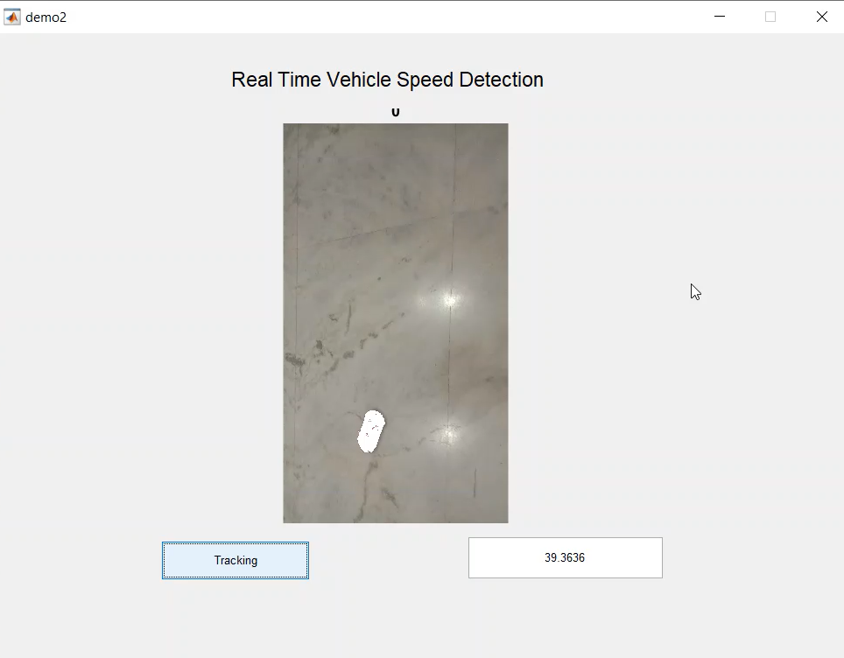
Practical Implementation of Image Processing based Vehicle Speed Monitoring System
Vehicle travelling at lower speed i.e. 23.40 Kmph.
Vehicle travelling at Medium speed i.e. 39.36 Kmph.

Slide 18
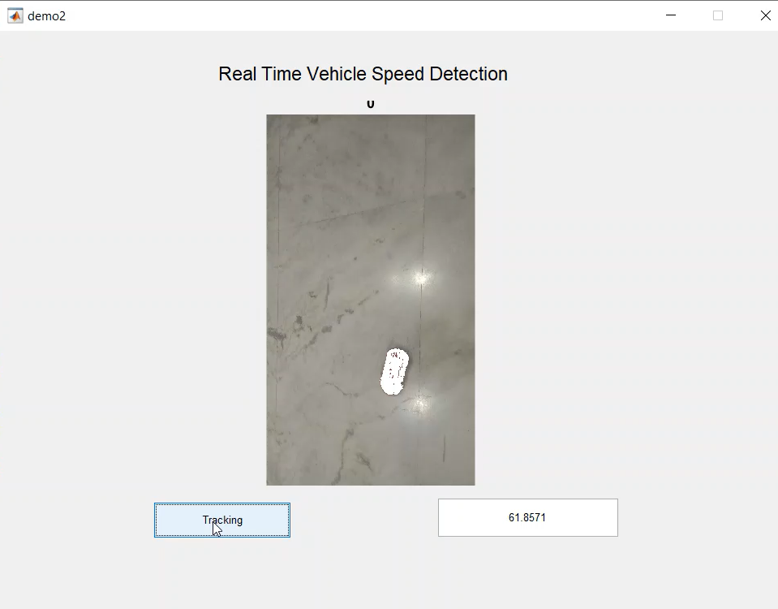
Practical Implementation of Image Processing based Vehicle Speed Monitoring System
Vehicle travelling at higher speed i.e. 61.85 Kmph.
With the calculated speeds of the vehicle we can conclude whether the vehicle is travelling at higher speed or lower one in order to avoid the major accidents taking place due to over speed.

Slide 19
Practical Implementation of Image Processing based Vehicle Speed Monitoring System
Comparative Analysis (Existed vs Proposed):
Existed
Proposed
Conventionally Radar technology is the current way used for speed detection. The main drawback of this method is the usage of radar guns.
Speed of only one object can be found at an instance.
While in use, if there are any devices that generate radio waves in the near vicinity, the results are influenced.
Extremely expensive.
Radar gun must be pointed towards the direct path of the incoming traffic.
The vehicle’s speed information is based on the video recorded using a camera. Theoretically we use methods such as Gaussian mixture models, DBSCAN, Kalman filter and Optical flow and make a practical Implementation.
The final speed of a particular vehicle is concluded by different natures of driving and its position at various instances of time of the recording.

Slide 20
Practical Implementation of Image Processing based Vehicle Speed Monitoring System
Conclusion & Future Scope:
As the rate of vehicle population is increasing rapidly, it is necessary to track and detect the speed of the vehicle. Therefore an effective system is built using image processing techniques to monitor the speed of the vehicles.
This concept can be further extended by using caliberated camera for much efficient results for the hardware purpose.
This method can also be developed for detecting the speed of multiple vehicles and overcome the issues such as fog.

Slide 21
Practical Implementation of Image Processing based Vehicle Speed Monitoring System
References:
[1] J. Gerát, D. Sopiak, M. Oravec and J. Pavlovicová, "Vehicle speed detection from camera stream using image processing methods," 2017 International Symposium ELMAR, Zadar, 2017, pp. 201-204, doi: 10.23919/ELMAR.2017.8124468.
[2] P. K. Thadagoppula and V. Upadhyaya, "Speed detection using image processing," 2016 International Conference on Computer, Control, Informatics and its Applications (IC3INA), Tangerang, 2016, pp. 11-16, doi: 10.1109/IC3INA.2016.7863015.
[3] M. R. Haque, M. G. Moazzam, S. Islam, R. Das and M. S. Uddin, "Vehicle speed determination from video streams using image processing," 2016 International Workshop on Computational Intelligence (IWCI), Dhaka, 2016, pp. 252-255, doi: 10.1109/IWCI.2016.7860375.
[4] P. K. Bhaskar and S. Yong, "Image processing based vehicle detection and tracking method," 2014 International Conference on Computer and Information Sciences (ICCOINS), Kuala Lumpur, 2014, pp. 1-5, doi: 10.1109/ICCOINS.2014.6868357.
[5] B. S. Shobha and R. Deepu, "A Review on Video Based Vehicle Detection, Recognition and Tracking," 2018 3rd International Conference on Computational Systems and Information Technology for Sustainable Solutions (CSITSS), Bengaluru, India, 2018, pp. 183-186, doi: 10.1109/CSITSS.2018.8768743.

Slide 22
Practical Implementation of Image Processing based Vehicle Speed Monitoring System
Details of Publications:
The paper has been successfully accepted to the International Conference on Communication and Electronics Systems ICCES 2021.

Slide 23
Practical Implementation of Image Processing based Vehicle Speed Monitoring System
Any Questions/Discussions ???

Slide 24
Practical Implementation of Image Processing based Vehicle Speed Monitoring System
Thank You !!!

